Slide 1
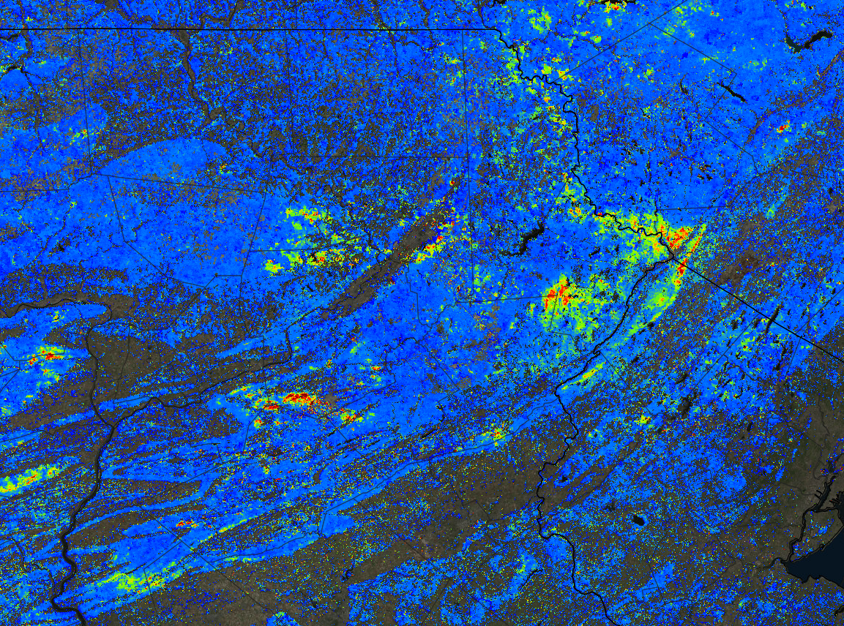

Slide 2
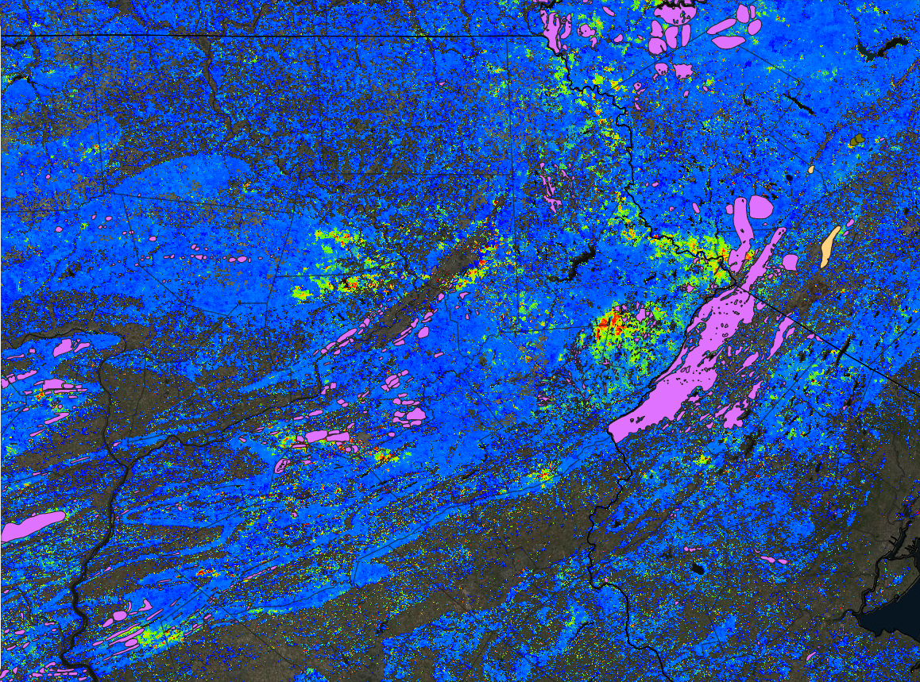
2008 ADS for GM vs FW Mean of All Years 7/10/2008
http://forwarn.forestthreats.org/fcav2?theme=MODIS_Forest_Change_Products&layers=AIK,NRTCTQ,AAC,AAB,AAX&mask=Forest&alphas=0.50,1,0.70,1,1&accgp=G04&basemap=Imagery&extent=-8703917.5694131,4910114.6093295,-8116881.1921833,5176115.4677617

